Slide 1

IntelleFlow: T-Bot Warriors

Slide 2
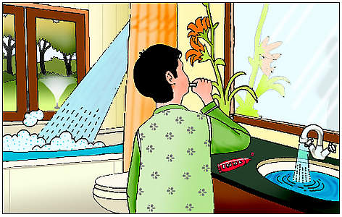
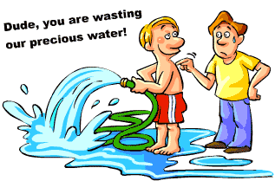
Problem
Only 2.5% of water on earth is freshwater, and only 1% of that freshwater is accessible
We MUST save our water

Slide 3
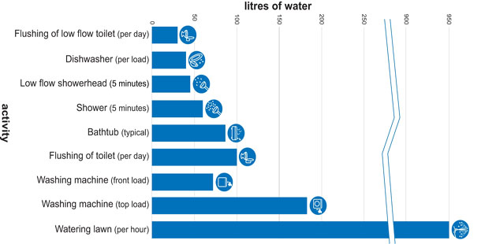
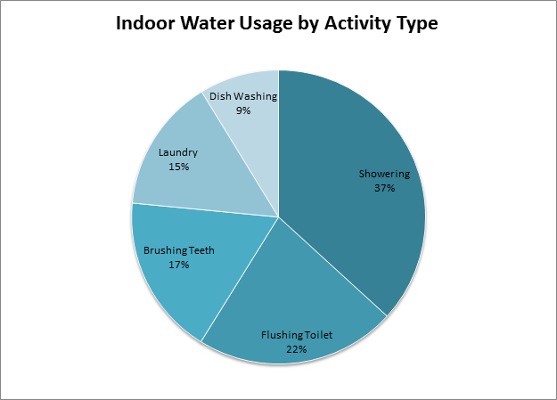
Statistics
An average Californian uses 196 gallons of water per day

Slide 4
Existing Solutions
Water Watcher – Monitor residential water use – Only an idea, no prototype
Water Pigeon – Automated Water metering Infrastructure
Minnesota requires that all installations of water be equipped with a flowmeter to measure the quantity of water used.
Disadvantages of existing solutions
None of the above solutions give any real time feedback for the user’s water usage.

Slide 5
Our Idea
We all know we should save water, but we have no idea how to tell if we are wasting water in the first place
Our idea:
A flow meter attached to every faucet that reports water usage
Displays the amount of water consumed.
The water usage is reported to the Google Cloud for analytics
This helps the user to reduce the usage

Slide 6
Purpose
Educate people about water wasting
Provide people with an easy way to know how much water they are using
Help people lower their water usage at home
Help consumers and companies save money
SAVE THE ENVIRONMENT

Slide 7
Flow Chart: Showerhead
Showerhead
Flow Sensor-
Measure pulses and water flow
-Can measure quality, density, and amount of particles
Timer- 5 min
Connected by cable, wireless, blue tooth
IOT KIT-
Collects and analyzes pulses from sensor as data
Not run out
Run out
Wifi connection
Google Cloud- stores data
Normal flow
Reduced flow
Wifi connection
Phone/device-
Displays data for user
Timer reset

Slide 8
Flow Chart: Large Scale
Dam/Lake
Reservoirs
Water Treatment Plant
House
Sewer
Recycle

Slide 9
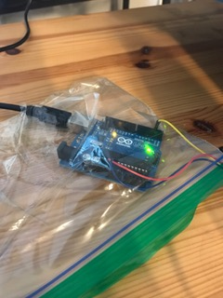
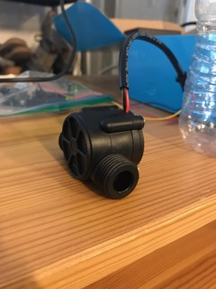
Flow Sensor and IOT Kit
Flow Sensor

Slide 10
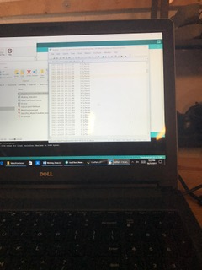
Sensor Readings

Slide 11
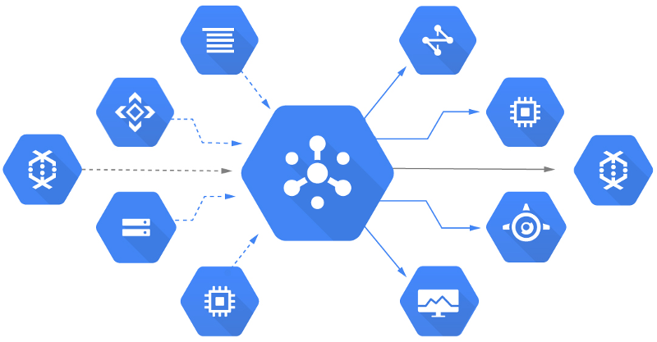
Google Cloud
Google Cloud Storage allows international storage and retrieval of any amount of data at any time .You can use Google Cloud Storage for a range of situations including serving website content, storing data for storage and disaster recovery, or distributing large data objects to users through direct download.

Slide 12
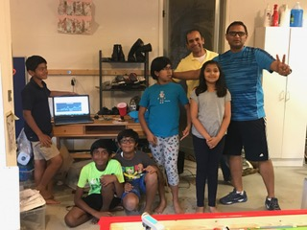
Proof of Concept
Sensor Data

Slide 13
Total Cost
Sensor cost - $17
IOT kit cost – $100
Google Cloud cost – FREE
With millions of people adopting this solution, the projected cost will be less than $5

Slide 14
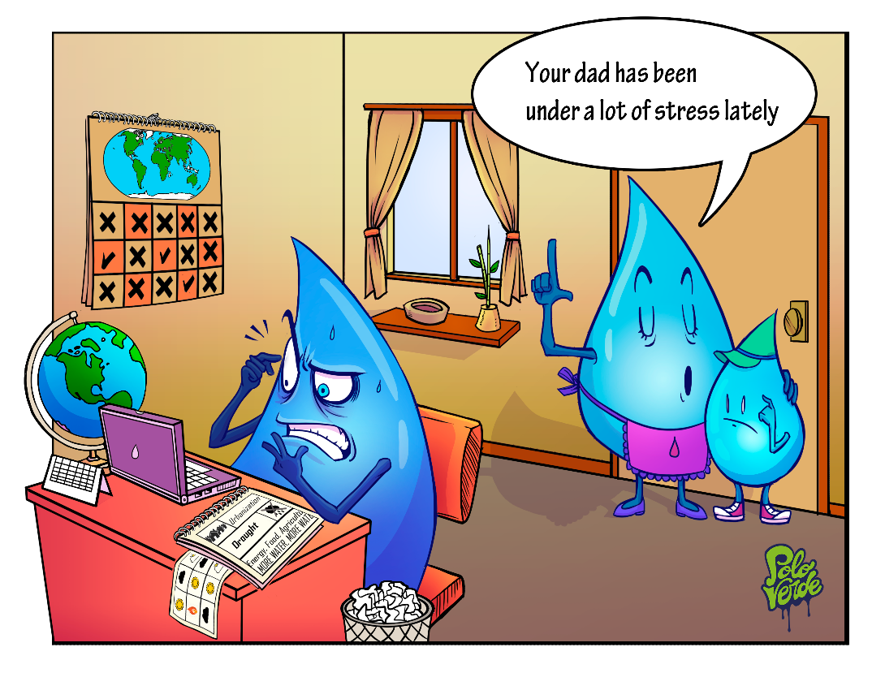
Conclusion
This solution will help many people by raising the awareness of water usage.
Users can:
- compare their water usage with their neighbors, get an idea of whether they are using more than the average household.
- get an idea of which faucet is consuming the most water and the time of water usage

Slide 15
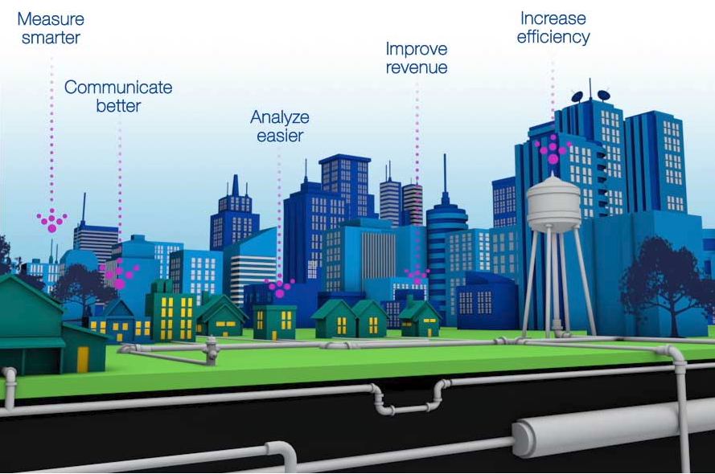
Conclusion Continued…
All of the sensor data is available on the Cloud and is analyzed with machine learning / data analysis.
Families will get weekly / monthly reports to tell if they are using more than the average household. It can also help prevent any water wastage due to leaks and carelessness
Based on the data, the government can provide discounts to reduce water usage and help families adopt water saving habits.
Ways our project helps

Slide 16
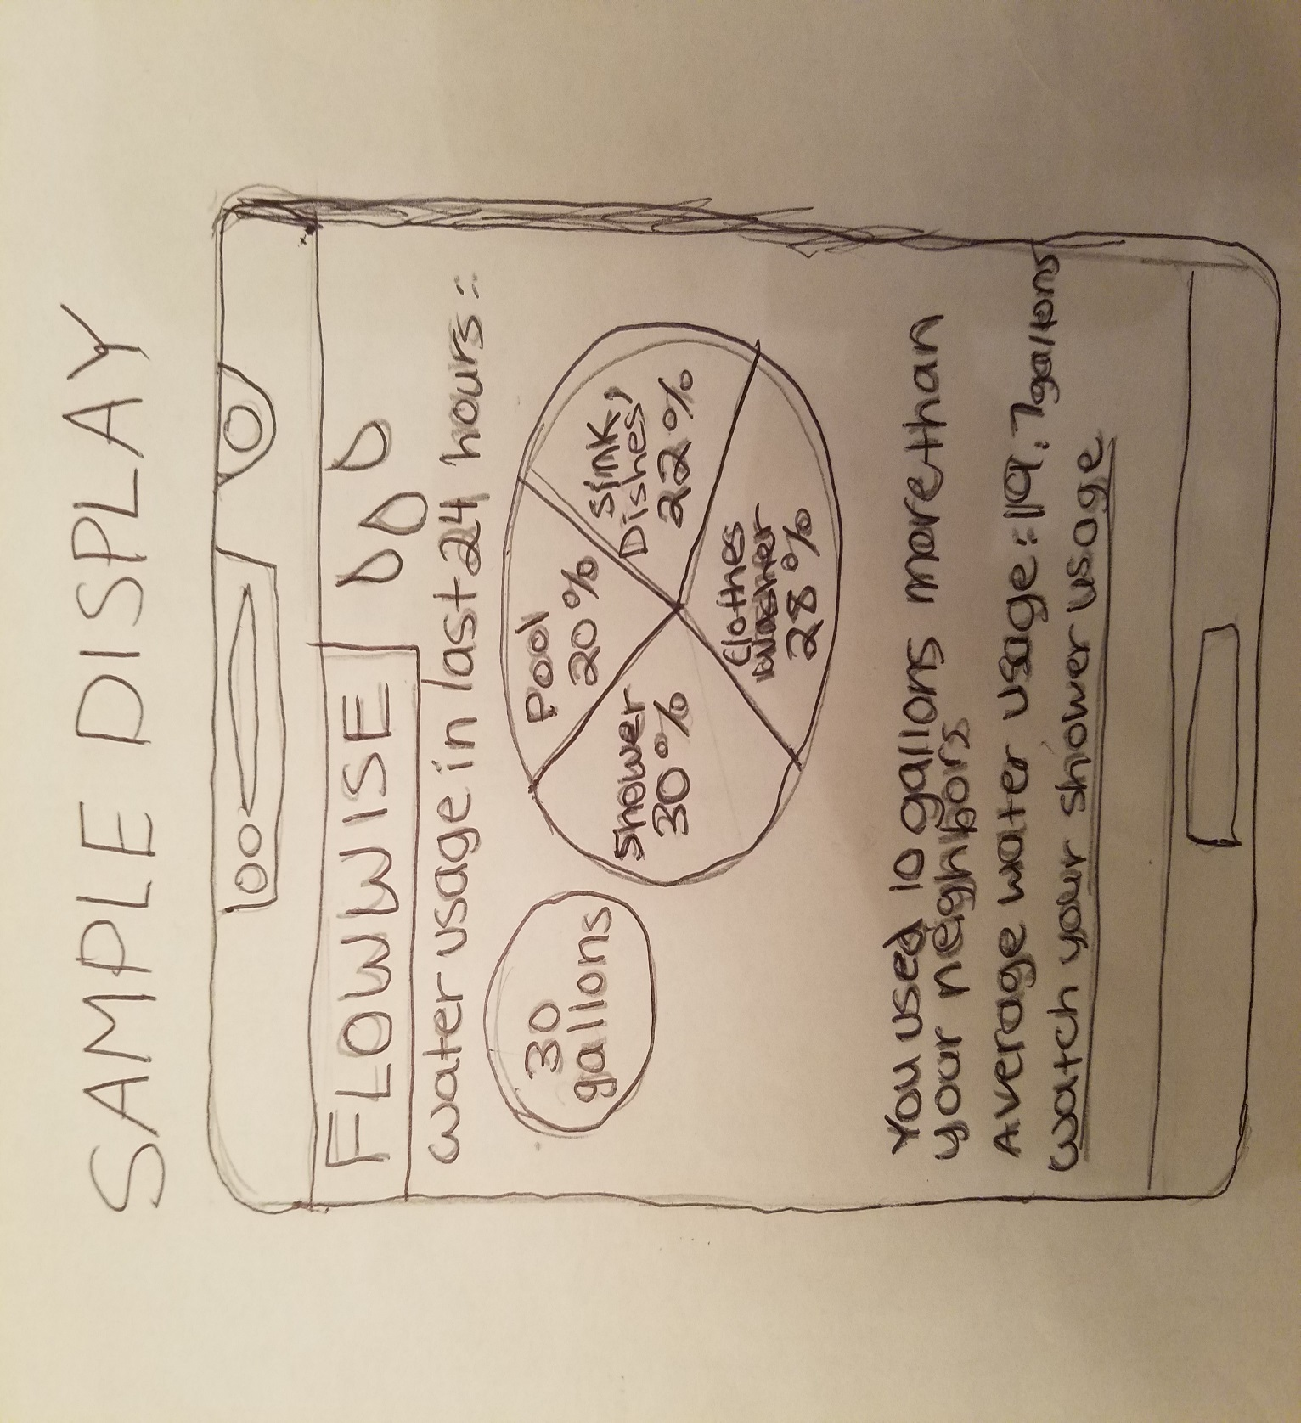
Sample Report

